Slide 1
Welcome to Arabic Level I by Kurzban

Slide 2

Lesson 12: الدرس الثاني عشر
Objectives:
Review
Arabic Alphabet: Two-Way Connectors
Arab States: Identifying and inquiring about Arab countries, capitals, and cities (lesson 12 + letters وغ ع
Practice
Summary
Flash card

Slide 3

How do you introduce yourself?

Slide 4
Do Now: Review
Listen to each word dictated to you and write it down on a ruled sheet of paper. Each word will be read twice.
طباشر فَيض
رتيب رصين
طريق ظريف

Slide 5
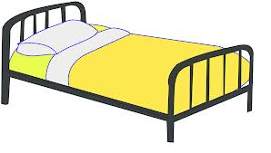

Lesson 12: Building up your vocabulary
Copy down and translate the following words on your paper several times and remember to proceed from right to left.
سَرير

Slide 6
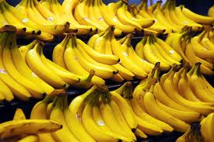
Lesson 12: Building up your vocabulary
Copy down and translate the following words on your paper several times and remember to proceed from right to left.
مَوْز

Slide 7
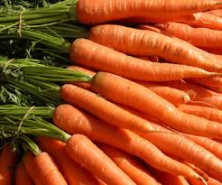
Lesson 12: Building up your vocabulary
Copy down and translate the following words on your paper several times and remember to proceed from right to left.
جَزَر

Slide 8
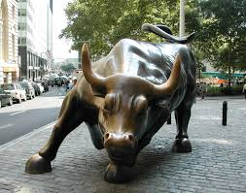
Lesson 12: Building up your vocabulary
Copy down and translate the following words on your paper several times and remember to proceed from right to left.
ثَور

Slide 9
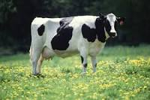
Lesson 12: Building up your vocabulary
Copy down and translate the following words on your paper several times and remember to proceed from right to left.
بقرة

Slide 10

Lesson 12: Building up your vocabulary
Copy down and translate the following words on your paper several times and remember to proceed from right to left.
دجاجة

Slide 11
Lesson 12: Building up your vocabulary
Copy down and translate the following words on your paper several times and remember to proceed from right to left.
Where? أيْنَ؟
When? مَتَى؟
Why? لِماذا؟
In what? In Which? (m./f.) فِي أيِّ؟ أيَّةِ؟

Slide 13
Lesson 12: Arabic Alphabet ع & غ
The letters ayn ع and gayn غ and their sound:
These two letters share one basic shape although they are 2 different sounds.
Examine these letters below and practice writing them.
Medial Independent

Slide 14
Lesson 12: Working with ع and غ
______________________________________ع
__________________________________غ ___

Slide 15
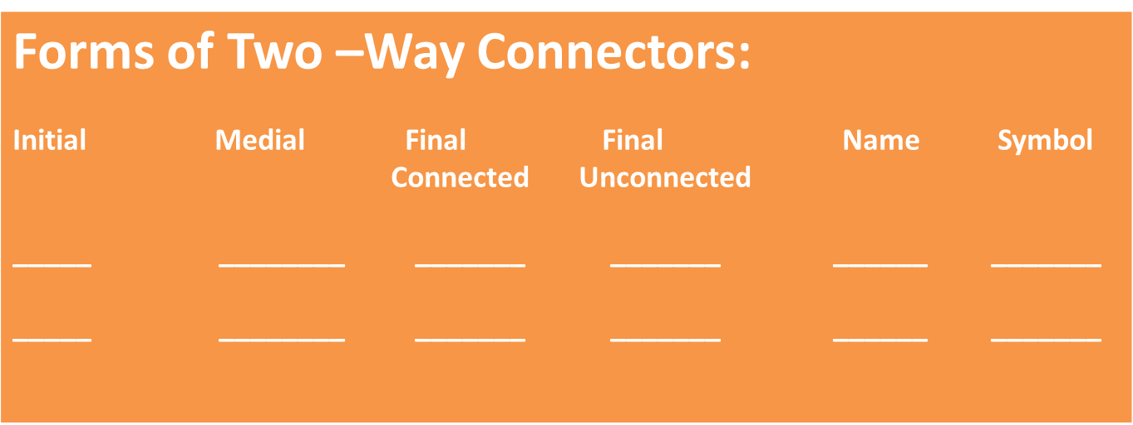
Lesson 12: Working with ع and غ

Slide 16
Combine the letters in each set, including short vowels, to form words
ع+ف+ر+ي+ت=
ف+ر+ا+غ=
ش+غ+و+ر=
د+ع=
ب+د=

Slide 17
Lesson 12: Mini Practice 1
Listen to the following words as you read them and repeat during practice. Then copy them several times on a ruled sheet of paper
_______________________________: غريب
عديد
يَعرِف
غريق

Slide 18
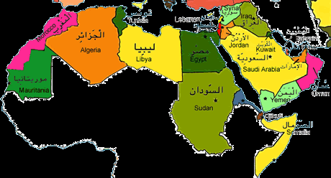
Lesson 12: Inquiring about and identifying Arabic Cities
The map below displays some of the names and locations of some Arab cities.

Slide 19
Lesson 12: Inquiring about and identifying Arabic Cities
For practice, ask your partner where certain town is located and answer the question using the name of that city and the country.
Here is an example:
أينَ بَغْداد؟
بَغْداد في العراق

Slide 20
Lesson 12: Inquiring about and identifying Arabic Cities
You might need to learn about capital cities of some Arab countries in order to finish this exercise.
Capital Country
المغرب الرباط
مصر القاهرة
لبنان بيروت

Slide 21
Dictation
Listen to each word dictated to you and write it down on a ruled sheet of paper. Each word will be read twice.
زوج
زوجة
أبن
بنت

